Slide 1
Final Findings

Slide 2






























It is a pleasure and an honour to be here with you today. We are now looking forward to presenting to you the final findings.
今天能和大家在一起，我感到非常荣幸。我们现在期待着向您展示贵司的最终结果。
Notes:
Introduction. Also an opportunity to talk a bit about Demix
Demix has LAs from across the globe and performs appraisals around the world
Demix is one of the largest CMMI services providers globally
Demix also provide other citification services, such as ISO, COBIT, MAX
It is a pleasure and honour to be here with you today. We are looking forward to work with you and your team over the coming days.
早晨好。今天我很高興和榮幸來到這裡，我期待著在未來的几天里與您和您的團隊一起工作。

Slide 3
Agenda 议程
Appraisal Overview 评估概述
Practice Area Findings 实践域发现
Performance Report 性能报告
Ratings 评级
Annexures 附加展示
Non model findings
Improvement opportunities
Next steps

Slide 4
Appraisal Overview 评估概述
Notes:
Information in this section should come from the appraisal plan. The idea here is not to duplicate the contents of the plan, but to provide a summary for the Appraisal Sponsor, and the personnel from the OU who will see these findings.
The ATL may add additional information to the final findings presentation, but this minimum content must be present.

Slide 5
Appraisal Overview
Notes:
This is information that must be recorded in the appraisal plan.

Slide 6
Appraisal Overview
Notes:
This is information that must be recorded in the appraisal plan.

Slide 7
Business and Appraisal Objectives

Slide 8
Appraisal Principles
Start with a process framework 以一个过程框架作为开始
Observe strict confidentiality and non-attribution 严格遵循保密性和不归因性
Involve senior management as appraisal sponsor 把高层作为评估发起人
Approach appraisal collaboratively to the extent possible 评估需要协调合作进行
Focus on action 关注行动
Notes:
1, what ever you share is confidential with the ATM’s and
2, non – your name will not appear in any reports
collaboratively – we have representation from your side as well as ours last at the end there are always weaknesses and from there an improvement action is always undertaken

Slide 9
Virtual appraisals – Code of Conduct
When virtual interviews are planned for the appraisal, then virtual face-to-face (F2F) interviews are required to confirm the following:
Verifying interviewees are on camera
Verifying ATM identities and maximizing their participation
Verifying appraisal participant identities, e.g., interviewees, Appraisal Sponsor
Verifying only planned appraisal participants are present
Verifying that non-attribution and confidentiality rules are being followed, e.g., no other participants are present, physical setting is appropriate
Monitoring non-verbal communication and appraisal participant engagement
当评估计划进行虚拟面试时，需要进行虚拟面对面（F2F）面试以确认以下内容：
确认受访者出现在摄像头前
验证ATM身份并最大化他们的参与
验证评估参与者的身份，例如，受访者、评估赞助人
确认只有计划中的评估参与者在场
验证非归属和保密规则是否被遵守，例如，没有其他参与者在场，物理环境是否适宜
监控非言语交流和评估参与者的参与度

Slide 10
Appraisal Team and Support Personnel
Notes:
Take basic information from the appraisal plan.

Slide 11
Appraisal Scope – Benchmark Model View
Notes:
Make sure the version of the model is correct when this slide is built. Replace the bold, italicized x with the correct version number.

Slide 12
Appraisal Scope – Organizational Scope

Slide 13
Appraisal Scope – Organizational Sample
Notes:
The ATL can show the chart from the generated random sample, but there must be a description of the sampled projects and their selected CA/PA grouping.

Slide 14
Appraisal Scope – Organizational Sample

Slide 15
Appraisal Scope – Organizational Sample

Slide 16
Findings Definitions – Required Categories
Required Findings Categories:
Weaknesses: A type of preliminary or final finding, which is an ineffective, or lack of, implementation of one or more processes that meet the intent and value of a practice based on verified objective evidence, and applicable across the project(s) and organizational support functions (OSFs) or Organizational Unit as a whole. This is realized either by a) the process itself does not address a CMMI practice requirement, or b) the project(s) or OSFs are not following their process that meets the intent and value of the applicable CMMI practice.
Strengths: A type of preliminary or final finding, which is an exemplary or noteworthy implementation of a process that meets the intent and value of a CMMI model practice.
必需的调查结果分类：
弱点：这是一种初步或最终的发现，涉及一个或多个流程的实施无效，或缺乏实施，这些流程基于验证的客观证据，旨在满足实践的意图和价值，并适用于整个项目、组织支持功能（OSFs）或组织单位。这种情况是由以下原因造成的：a) 流程本身没有满足CMMI实践要求，或者b) 项目或OSFs没有遵循符合适用CMMI实践的意图和价值的流程。
优点：这是一种初步或最终的发现，涉及一个过程的示范性或值得注意的实施，该过程满足CMMI模型实践的意图和价值。

Slide 17
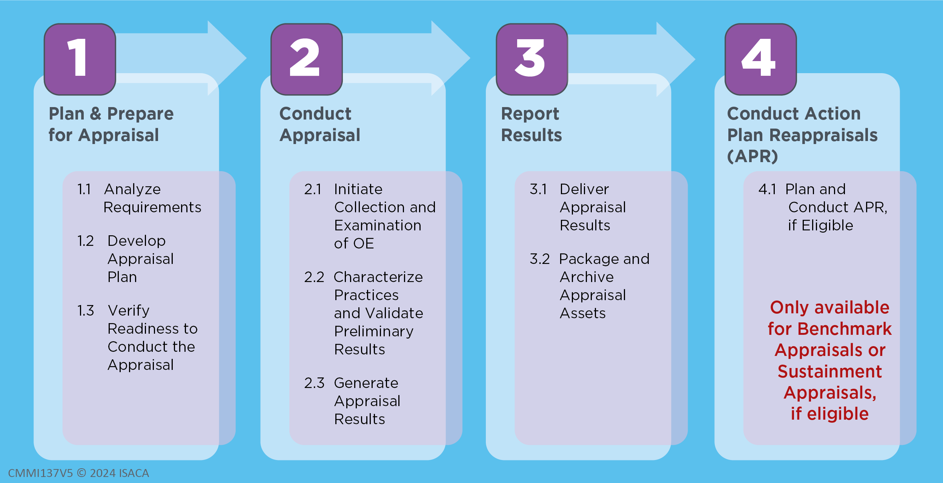
CMMI Appraisal Process – Appraisal Phases

Slide 18
Practice Area Findings 实践域发现

Slide 19

Causal Analysis and Resolution (CAR) 原因分析与解决
Intent: Identify causes of selected outcomes and take action to either prevent recurrence of undesirable outcomes or ensure recurrence of positive outcomes. 识别选定结果的原因并采取行动，防止不想要的结果再次发生或确保再次出现正面结果。
Value: Addressing root cause issues eliminates rework and directly improves quality and productivity. 解决根本原因问题可以消除返工并直接提高质量和生产率。
Strengths 强项:
None 没有
Weaknesses 弱项:
None 没有

Slide 20

Configuration Management (CM) 配置管理
Intent: Manage the integrity of work products using configuration identification, version control, change control, and audits. 使用配置识别、版本控制、变更控制和审计来管理工作产品的完整性。
Value: Reduces loss of work and increases the ability to deliver the correct version of the solution to the customer. 减少工作损失，并增加向客户提供正确版本解决方案的能力。
Strengths 强项:
None 没有
Weaknesses 弱项:
None 没有

Slide 21

Decision Analysis and Resolution (DAR) 决策分析与解决
Intent: Make and record decisions using a recorded process that analyzes alternatives. 使用分析备选方案的已记录过程做出并记录决策。
Value: Increases the objectivity of decision making and the probability of selecting the optimal solution. 增加决策的客观性和提高找到最佳解决方案的概率。
Strengths 强项:
None 没有
Weaknesses 弱项:
None 没有

Slide 22

Estimating (EST) 估算
Intent: Estimate the size, effort, duration, and cost of the work and resources needed to develop, acquire, or deliver the solution. 估算开发、采购或交付解决方案所需的工作和资源的规模、工作量、周期和成本。
Value: Estimation provides a basis for making commitments, planning, and reducing uncertainty, which allows for early corrective actions and increases the likelihood of meeting objectives. 估算为做出承诺、策划和减少不确定性提供了依据，有助于尽早采取纠正措施并提高实现目标的可能性。
Strengths 强项:
None 没有
Weaknesses 弱项:
None 没有

Slide 23

Governance (GOV) 管治
Intent: Provides guidance to senior management on their role in the sponsorship and governance of performance, processes, and related activities. 为高层提供关于他们在绩效、流程和相关活动的发起和管治中的角色的指导。
Value: Minimizes the cost of process implementation, increases the likelihood of meeting objectives, and ensures that the implemented processes support and contribute to the success of the business. 最大限度地降低过程实施成本，提高实现目标的可能性，并确保实施的过程支持并促成业务成功。
Strengths 强项:
None 没有
Weaknesses 弱项:
None 没有

Slide 24

Implementation Infrastructure (II) 实施基础条件
Intent: Ensure that the processes and assets important to an organization’s performance are habitually and persistently followed, used, and improved. 确保对组织绩效重要的流程和资产得到习惯性和持续性的遵循、使用和改进。
Value: Sustains the ability to consistently achieve goals and objectives efficiently and effectively. 维持有效和高效地实现目标的能力。
Strengths 强项:
None 没有
Weaknesses 弱项:
None 没有

Slide 25

Managing Performance and Measurement (MPM) 管理绩效与度量
Intent: Manage performance using measurement and analysis to achieve business objectives. 使用度量和分析来管理性能，以实现业务目标。
Value: Maximizes business return on investment by focusing management and improvement efforts on cost, schedule, and quality performance. 将管理和改进工作集中在成本、进度和质量性能上，最大限度地提高业务投资回报。
Strengths 强项:
None 没有
Weaknesses 弱项:
None 没有

Slide 26

Monitor and Control (MC) 控制与监督
Intent: Provide an understanding of the project progress so appropriate corrective actions can be taken when performance deviates significantly from plans. 提供对项目进度的掌握，以便在绩效显著偏离计划时采取适当的纠正措施。
Value: Increases the probability of meeting objectives by taking early actions to adjust for significant performance deviations. 通过及早采取行动调整显著绩效偏差，提高达成目标的可能性。
Strengths 强项:
None 没有
Weaknesses 弱项:
None 没有

Slide 27

Organizational Training (OT) 组织级培训
Intent: Develop the skills and knowledge of personnel so they perform their roles efficiently and effectively. 培养人员的技能和知识，以便他们高效且有效地执行他们的角色。
Value: Enhances individuals’ skills and knowledge to improve organizational work performance. 增强个人的技能和知识，提高组织工作性能。
Strengths 强项:
None 没有
Weaknesses 弱项:
None 没有

Slide 28

Peer Reviews (PR) 同行评审
Intent: Identify and address process performance work product issues through reviews by the producer’s peers or Subject Matter Experts (SMEs). 通过生产同行或主题专家（SME）的审查，识别和解决过程绩效工作产品问题。
Value: Reduce cost and rework by uncovering issues or defects early. 及早发现问题或缺陷，降低成本和返工。
Strengths 强项:
None 没有
Weaknesses 弱项:
None 没有

Slide 29

Planning (PLAN) 策划
Intent: Develop plans to describe what is needed to accomplish the work within the standards and constraints of the organization 制定计划来描述在组织的标准和约束条件内完成工作所需的内容
Value: Optimizes cost, functionality, and quality to increase the likelihood of meeting objectives. 优化成本、功能和质量以增加实现目标的可能性。
Strengths 强项:
None 没有
Weaknesses 弱项:
None 没有

Slide 30

Process Asset Development (PAD) 过程资产开发
Intent: Develop and keep updated the process assets necessary to perform the work. 开发并保持更新执行工作所需的过程资产。
Value: Provides a capability to understand and repeat successful performance. 提供了解和重复成功性能的能力。
Strengths 强项:
None 没有
Weaknesses 弱项:
None 没有

Slide 31

Process Management (PCM) 过程管理
Intent: Manages and implements the continuous performance improvement of processes and infrastructure to meet business objectives by identifying and implementing the most beneficial process improvements and making performance results visible, accessible, and sustainable. 管理和实施过程和基础设施的持续性能改进，以识别和实施能够带来最大效益的过程改进，以使性能结果可见、可使用和可持续，从而实现业务目标。。
Value: Ensures that processes, infrastructure, and their improvement contribute to successfully meeting business objectives. 确保过程、基础条件及其环境有助于成功实现业务目标。
Strengths 强项:
None 没有
Weaknesses 弱项:
None 没有

Slide 32

Process Quality Assurance (PQA) 过程质量保证
Intent: Verify and enable improvement of the quality of the processes performed and resulting work products. 验证并支持已执行的过程和所得工作产品的质量改进。。
Value: Increases the consistent use and improvement of the processes to maximize business benefit and customer satisfaction. 增强过程使用和改进的一致性，以最大限度地提高业务效益和客户满意度。
Strengths 强项:
None 没有
Weaknesses 弱项:
None 没有

Slide 33

Product Integration (PI) 产品集成
Intent: Integrate and deliver the solution that addresses functionality, performance, and quality requirements. 集成并交付满足功能、性能和质量需求的解决方案。
Value: Increases customers’ satisfaction by giving them a solution that meets or exceeds their functionality and quality requirements. 通过提供达到或超过其功能和质量要求的解决方案来提高客户的满意度。
Strengths 强项:
None 没有
Weaknesses 弱项:
None 没有

Slide 34

Requirements Development and Management (RDM) 需求开发与管理
Intent: Elicit requirements, confirms common understanding by stakeholders, and align requirements, plans, and work products. 引导需求，确认干系人对需求有共同理解，并保持需求、计划和工作产品相一致。
Value: Increases likelihood that the solution meets or exceeds customer expectations and needs. 提高解决方案满足或超出客户期望和需求的可能性。
Strengths 强项:
None 没有
Weaknesses 弱项:
None 没有

Slide 35

Risk and Opportunity Management (RSK) 风险与机会管理
Intent: Identifies, records, analyzes, and manages potential risks or opportunities. 识别、记录、分析和管理潜在风险或机会
Value: Mitigates adverse impacts or capitalizes on positive impacts to increase the likelihood of meeting objectives. 缓解不利影响或充分利用积极影响来提高实现目标的可能性。
Strengths 强项:
None 没有
Weaknesses 弱项:
None 没有

Slide 36

Technical Solution (TS) 技术解决方案
Intent: Designs and builds solutions that meet requirements. 设计和构建满足需求的解决方案
Value: Provides a cost-effective design and solution that meets customer requirements and reduces rework. 提供高效的设计和解决方案，以满足客户需求并且减少返工。
Strengths 强项:
None 没有
Weaknesses 弱项:
None 没有

Slide 37

Verification and Validation (VV) 验证与确认
Intent: Confirms selected solutions and components meet their requirements, and demonstrates selected solutions and components fulfill their intended use in their target environment. 确认所选的解决方案和组件符合各自的要求，并证明所选的解决方案和组件能够在目标环境中实现预期用途。
Value: Increases the likelihood that the solution will satisfy the customer. 提高解决方案满足客户需求的可能性。
Strengths 强项:
None 没有
Weaknesses 弱项:
None 没有

Slide 38
Performance Report 性能报告

Slide 39
Ratings 評級

Slide 40
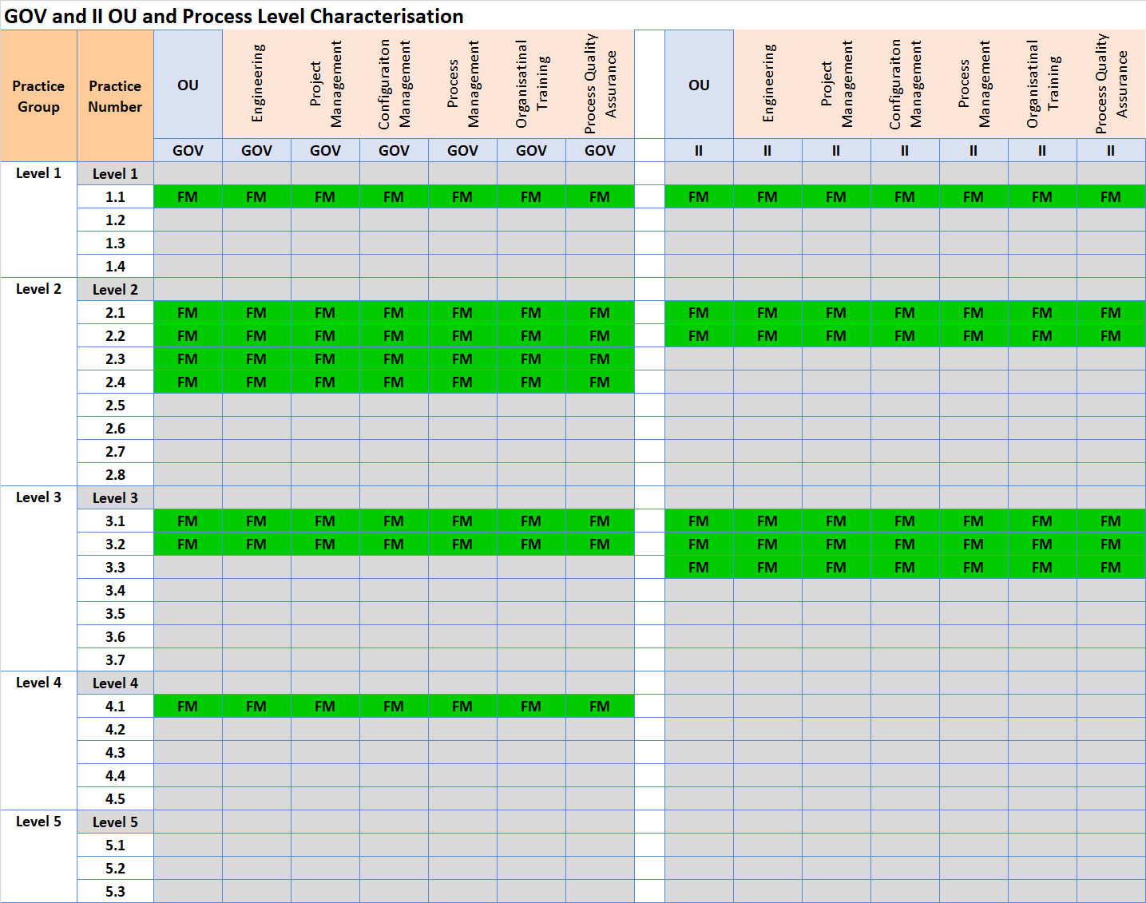
Ratings for
Notes:
For each practice, enter the OU-Level characterization (FM, LM, PM, DM, NY). The chart will set a color.
Based on the characterizations of all practices in each practice level, set the Practice Level rating to “S” (Satisfied) or “U” (Unsatisfied).
The PA Rating is the Highest Practice Level at which all practices for it, and all lower Practice Levels, are Satisfied.
For details, see the MDD, Activity 2.3.2 Determine Practice Group Ratings, and Activity 2.3.3 Determine Practice Area and Maturity Level or Capability Level Profile Rating.

Slide 41
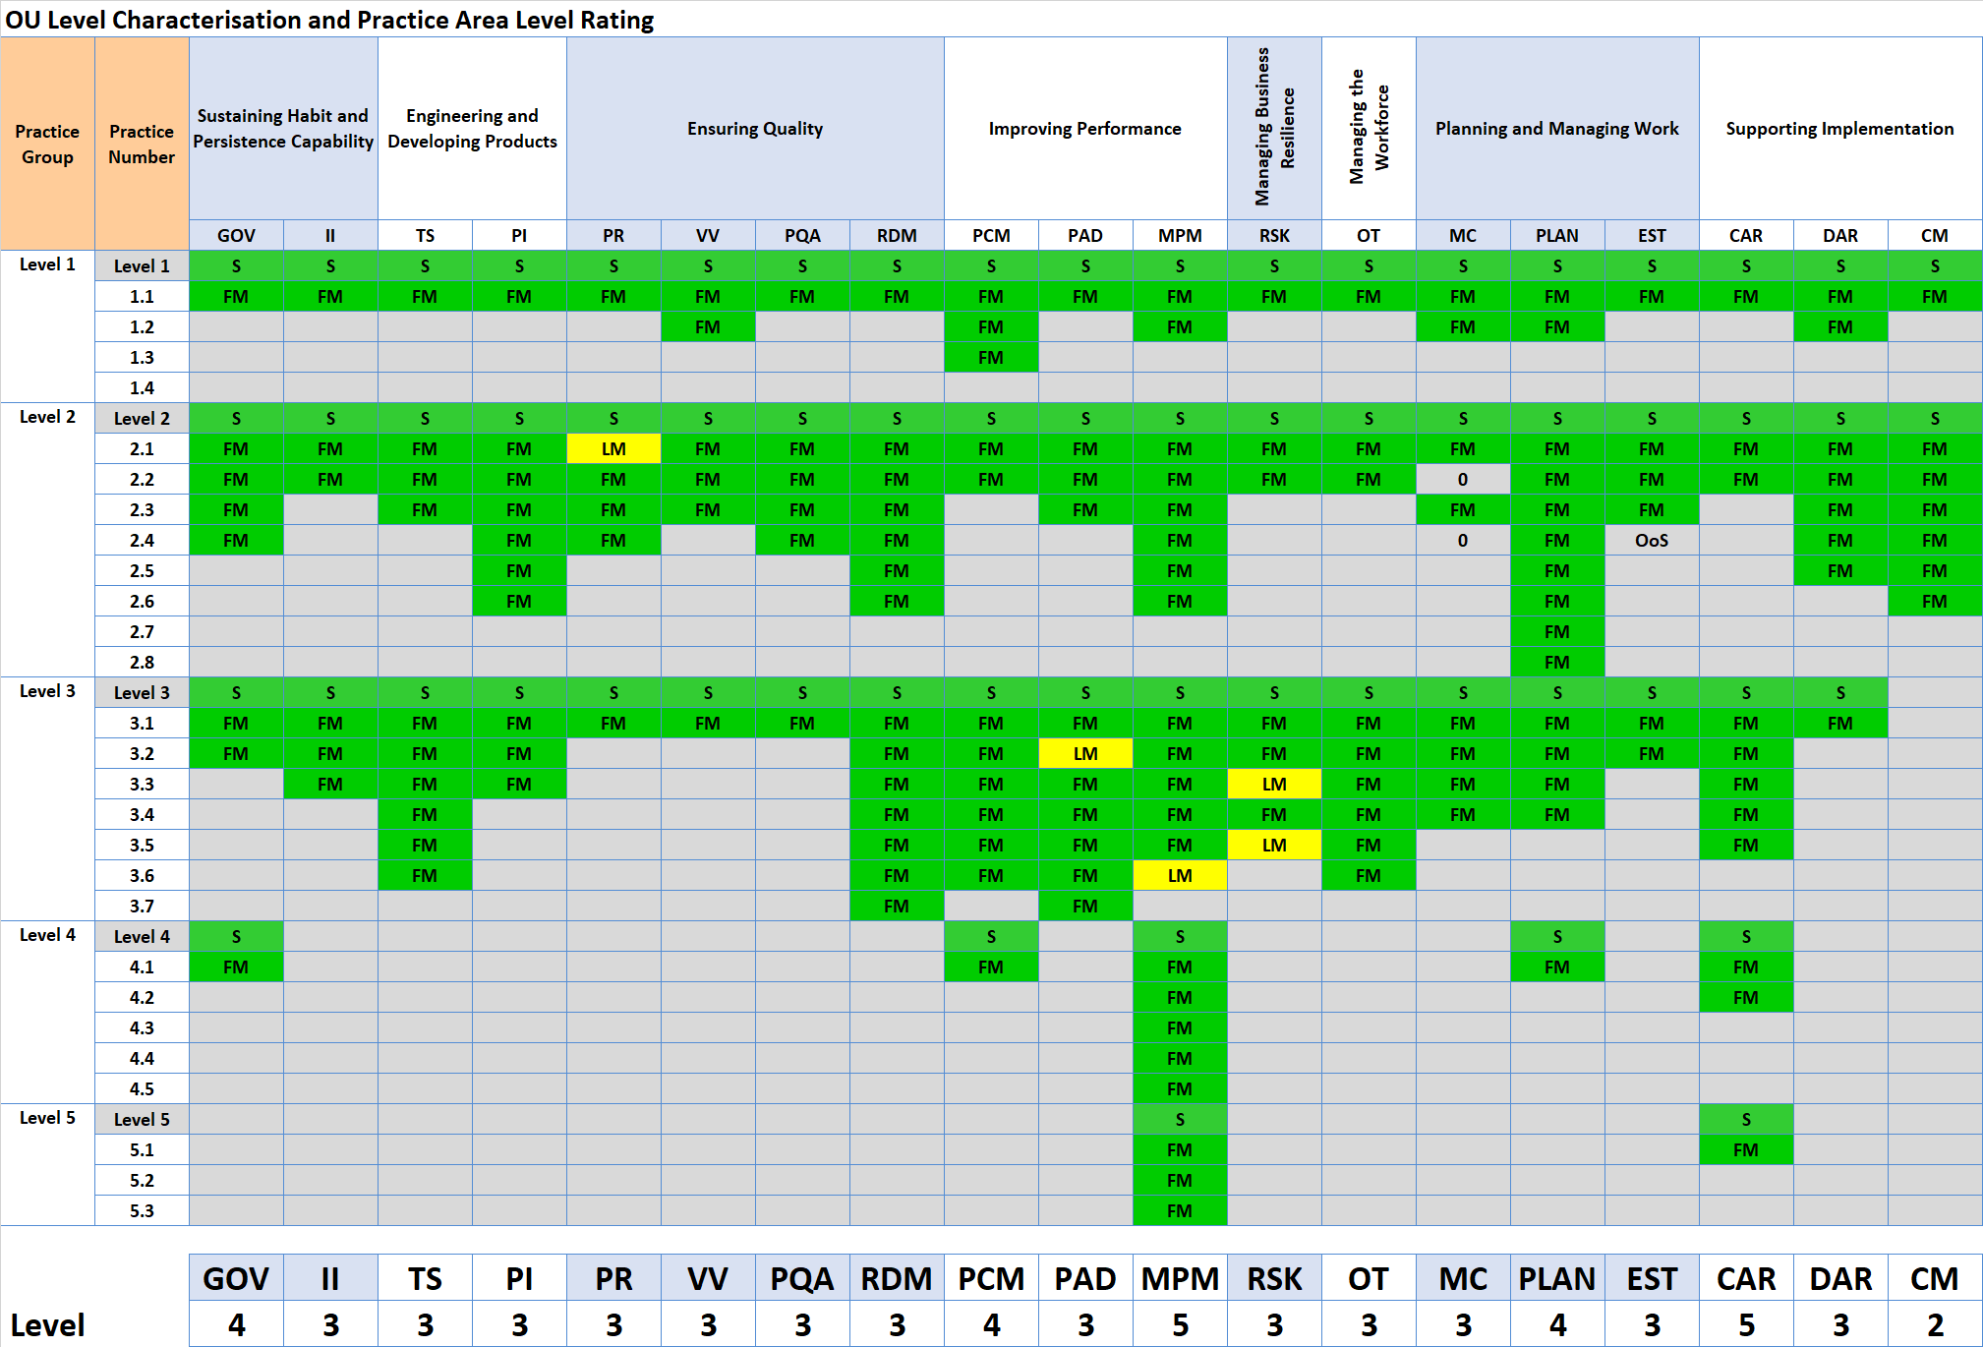
Ratings for
Notes:
For each practice, enter the OU-Level characterization (FM, LM, PM, DM, NY). The chart will set a color.
Based on the characterizations of all practices in each practice level, set the Practice Level rating to “S” (Satisfied) or “U” (Unsatisfied).
The PA Rating is the Highest Practice Level at which all practices for it, and all lower Practice Levels, are Satisfied.
For details, see the MDD, Activity 2.3.2 Determine Practice Group Ratings, and Activity 2.3.3 Determine Practice Area and Maturity Level or Capability Level Profile Rating.

Slide 42
Congratulations!
On being rated
Maturity Level 5
恭喜贵公司顺利通过CMMI成熟度5级评估
Note: 注：
Before the results of this appraisal become public record, e.g., announced in a press release or on an organization’s public Web site, or used in response to a request for proposal, the appraisal must first be accepted by the ISACA CMMI quality team.
在评估结果正式公开之前，例如在新闻稿或公司官网上公开，或将其用于响应请求建议书之前，该评估须首先被ISACA CMMI 质量团队认可
This can take up to 8 weeks from the time that the appraisal results are submitted to the ISACA CMMI quality team for review. Results are submitted to the ISACA CMMI quality team typically within 4-6 working days after the final findings presentation has been made.
从将评估结果提交给ISACA CMMI质量团队起，最长可能需要8周进行审核。通常在完成最终发现展示后的4-6个工作日内，评估结果会提交给ISACA CMMI质量团队。

Slide 43
Appraisal Team Affirmations – Signature Page
I support the findings in this presentation and affirm that to the best of my knowledge it represents an accurate portrayal of the state of the process in the appraised organization. 我支持本报告中的发现结果，并确认以上发现准确地描述了被评估组织的过程状态。

Slide 44
Annexures 附加展示

Slide 45
Non model findings

Slide 46
Non model findings

Slide 47
Findings Definitions – Optional Findings Categories
Notes: Additional explanatory information regarding weaknesses or strengths, e.g., examples, supporting indicators, and consequences resulting from weaknesses. Notes must NOT be used as a category in lieu of weaknesses.
Improvement Opportunity: A type of preliminary or Final Findings about a particular process that meets the intent and value of a model practice but represents an opportunity where the process could be improved to provide more value.
Improvements in Progress: A type of preliminary or Final Findings statement that is a reflection of the current state of a Practice Area or practice which is newly implemented for the project(s) or Organizational Unit and shows promise of helping to achieve further improvement. Due to the recent nature of that process implementation, artifacts may be limited.
Recommendations/Next Steps: Recommendations by the appraisal team for ways to address findings. These must not be conveyed as mandatory or guarantees of future characterizations or ratings. Recommendations must be either a separate report or separate section from the main appraisal findings, including the ratings and a disclaimer that “These recommendations are not mandatory nor guarantee of addressing findings or future characterizations or ratings.”

Slide 48
Improvement Opportunities
CAR 2.1 - Consider also using opportunity data as outcomes for further analysis. 考虑将机会数据用作进一步分析的结果。

Slide 49
Improvement Opportunities - continued
CAR 2.1 - Consider also using opportunity data as outcomes for further analysis. 考虑将机会数据用作进一步分析的结果。

Slide 50

DEMIXIUM™
Demixium™ Copyright Demix 2021-2023
Demixium is a collection of best practices to assess an organisation across a variety of domains and best practice models. It is available for free use under the MIT free use license agreement.
Demixium 是一组最佳实践的集合，用于跨各种领域和最佳实践模型评估组织。 它可根据 MIT 免费使用许可协议免费使用。
www.demixium.com
Knowledge | Performance | Results

Slide 51
Next steps

Slide 52
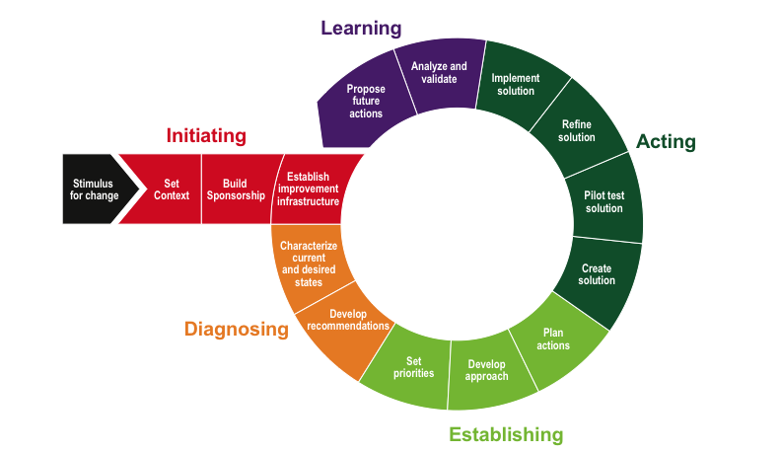
Re-appraisal
Continuous improvement over next 3 years
Re appraise
The IDEAL Model

Slide 53
CERTIFICATE

Slide 54
Notice
This pptx has embedded links to 00_Data_Reference.xlsm
The latest information and version of the Benchmark Appraiser Support Environment (BASE) can be accessed at www.demix.org/tools

